Slide 1
LAST CLASS OF HTML

Slide 2
BRIEFLY ABOUT WHAT WAS LEARNED

Slide 3


Slide 4
WRITING HTML:
<b> Ovo je neki tekst u HTML </b>
Tag entry
Tag end

Slide 5
LAST EXERCISE

Slide 6

SOURCE: COLT STELEE

Slide 7

SOURCE: COLT STELEE

Slide 8


Slide 9


INLINE ELEMENTI:
BLOCK ELEMENTI:
SOURCE: COLT STELEE

Slide 10
SEMANTIC ELEMENTS:

Slide 11
SEMANTIC = MEANING

Slide 12
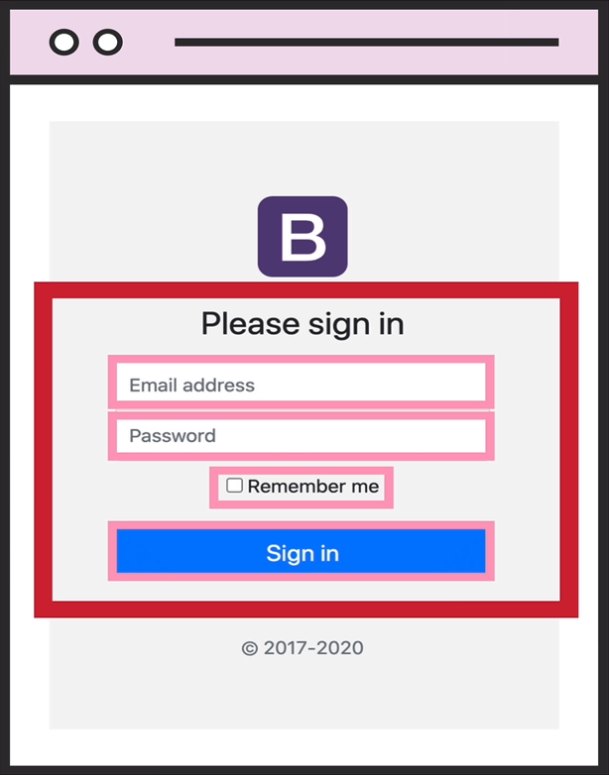
CREATING FORMS
Forms have no effect on appearance
Inside the form we put INPUT, CHECKBOX, BUTTON, which actually makes a difference
The most important attribute is action=""
SOURCE: COLT STELEE

Slide 13
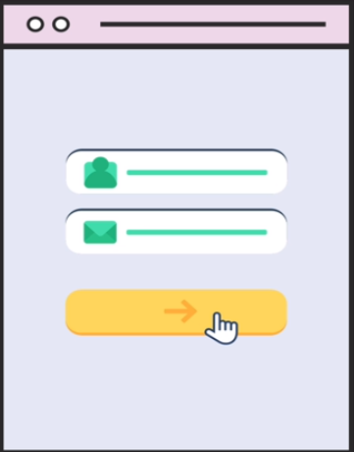
<INPUT>
We use <input> to create various types (20+) of input data for the user
The type=“” attribute is most important for <input>
SOURCE: COLT STELEE

